Slide 1
PDE4444
Week 2 Part 2: Binary Classification

Slide 2
Supervised learning
Our data is composed by 𝑛 observations.
Each observation contains an independent value of
𝒙 = [𝑥₁,..., 𝑥_{m}]^{T} (𝑚 independent variables)
𝑦 (1 continuous dependent variable)
Regression
𝑦
is continuous
We imagine that our data contains a true pattern 𝑓 𝒙 and some noise 𝜀:
𝑦 = 𝑓(𝒙) + 𝜀

Slide 3
Supervised learning
Our data is composed by 𝑛 observations.
Each observation contains an independent value of
𝒙 = [𝑥₁,..., 𝑥_{m}]^{T} (𝑚 independent variables)
𝑦 (1 discrete dependent variable)
Classification
𝑦
is discrete
We imagine that our data contains a true pattern 𝑓 𝒙 and some noise 𝜀:
𝑦 = 𝒟( 𝑓(𝒙) + 𝜀 )

Slide 4
In this lesson …
Classification:
Binary Classifier
Logistic Regression

Slide 5
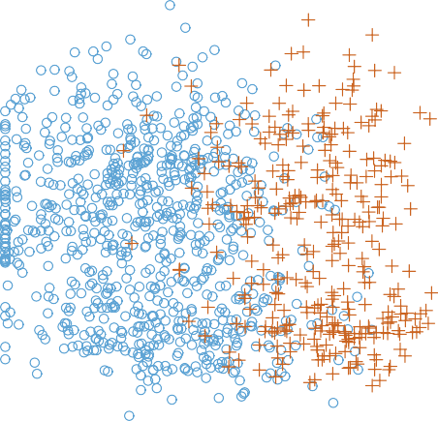
Example of classification
Independent variables:
Size
Color
Dependent variable
Fruit Type
Color
You can see that the response variable is discrete (two values, orange and blue dots in the plot).
Size

Slide 6
Binary Classifier
The output is two Classes
Classifier dimension:
m-1, where m is the data dimension (number of independent variables)
Example: Fruit classification to Bananas and Oranges based on the size and the color
m = 2 → 2-D
Classifier is a line → 1-D

Slide 7
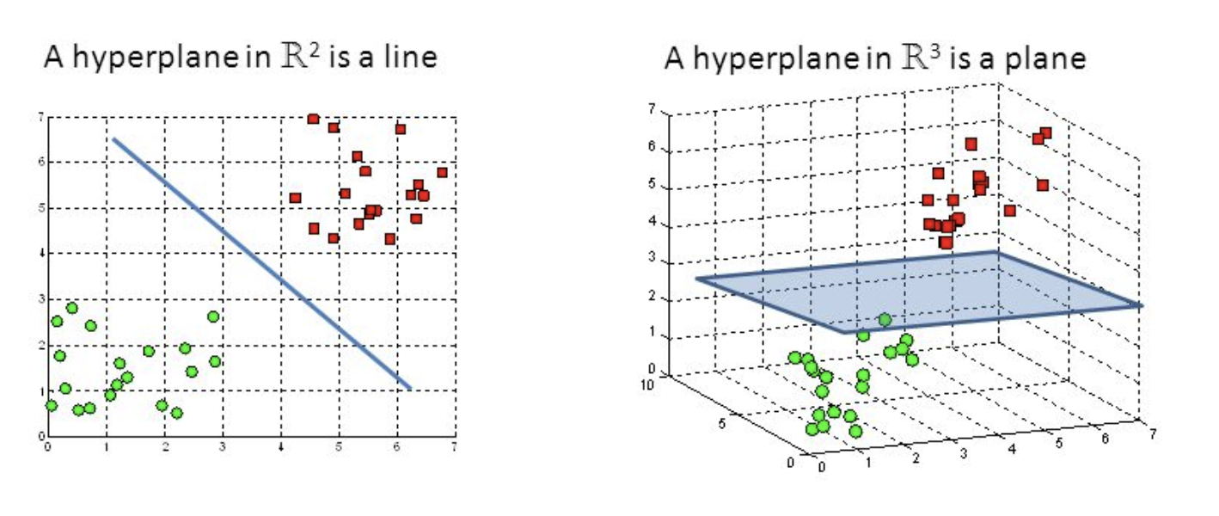
2-D Vs 3-D
X2
X2
X3
X1
X1

Slide 8
Logistic Regression

Slide 9
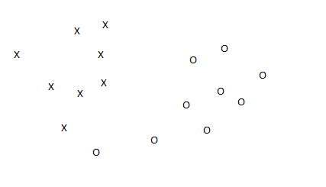
Binary Classifier
How?
The classification algorithm will find the best line to separate the two classes (linear classifier)
Which line in the best line?

Slide 10
Binary Classifier
How?
The classification algorithm will find the best line to separate the two classes (linear classifier)
Which line in the best line?
Maximum Margin

Slide 11






Binary Linear Classifier
What if the problem is not linearly separable?
One solution: dimension transformation
Example: XOR Problem
X1 | X2 | Y
1 | 1 | 0
1 | 0 | 1
0 | 1 | 1
0 | 0 | 0

Slide 12
Logistic Regression
In this Section we describe a fundamental framework for linear two-class classification called logistic regression.
Logistic regression follows naturally from the regression framework regression introduced in the previous part.
The added consideration here is that data output is now constrained to take on only two discrete values; either the value 0 or +1.
So, after finding the linear combination of input features (Y= b₀ + b₁.X), we need to map the output to discrete value.

Slide 13
Logistic Regression with Step Function
Consider the following dataset, where we have two classes. Using step function to match our 0,1 labels.
Fitting a linear model (line) is not suitable.
Unfortunately, because here the Least Squares cost takes on only integer values.
How do we tune these parameters properly?

Slide 14
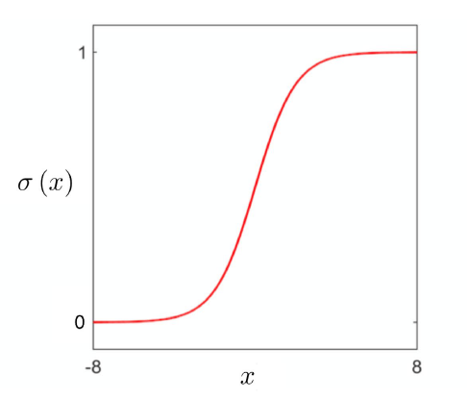
Logistic Regression with Sigmoid Function
The logistic Sigmoid Function
When we fit sigmoid function, instead of the step function, to map the linear model to discrete output, we are therefore performing regression with a logistic or logistic regression

Slide 15
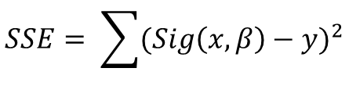
Logistic regression using the Least Squares cost
because we know that the output we deal with is limited to the discrete values 0 or 1, it is reasonable to ask if there is a more appropriate cost that is customized to deal with just such output.
$$SSE= \sum{{(Sig\left(x,β\right)−y)}^{2}}$$

Slide 16

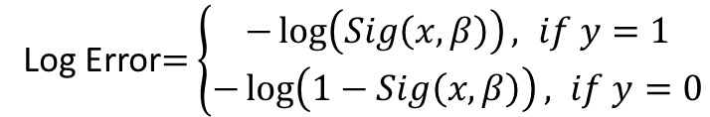
Logistic regression using the Cross Entropy cost
Such a point-wise cost does exist for these restricted output values.
One such cost - which we call the Log Error - is as follows (for a single point)
We can then form the so-called Cross Entropy cost function by taking the average of the Log Error costs over all datapoints as
The Cross Entropy cost is always convex regardless of the dataset used. Easy to be optimized
Log Error$=$ $\left\{\begin{aligned}−\log\left(Sig\left(x,β\right)\right), if y=1 \\ −\log\left(1−Sig\left(x,β\right)\right), if y=0\end{aligned}\right.$
$$\frac{\sum_{1}^{n}{LogError}}{n}$$

